Slide 1
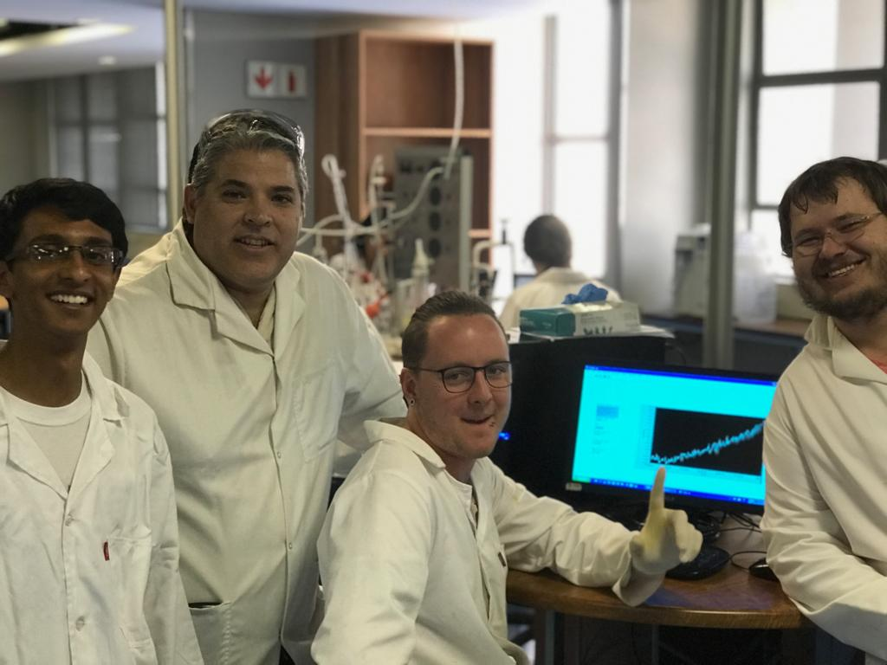
CLB 321: Chemical Kinetics 2019 - Group 19
A.M Barrios
B Bhaga
J Clasen
J.M Webber
96011930
17094128
15189385
12100952

Slide 2




Background
Reaction:
CH3COOCH2CH3+NaOH→CH3COONa+CH3CH2OH (A+B→C+D)
Reaction rate:
$$r_{A} = − k∙C_{A}^{m}∙C_{B}^{n}$$
Batch mole balance:
$${{dF}_{A}}/{dt}= r_{A}∙V$$
PFR mole balance:
$${{dF}_{A}}/{dV}= r_{A}$$
CSTR mole balance:
$$F_{AO} − F_{A}=− r_{A}∙V$$

Slide 3
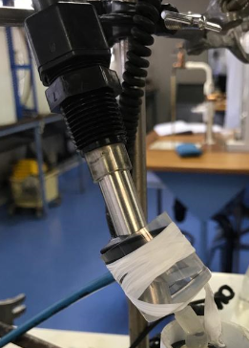
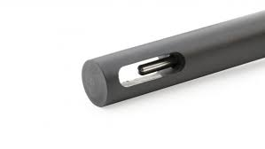


Experimental procedure
Conductivity Probe:
Insertion
No bubbles
Angled
Re-insert
Twist
Data reading
BEFORE reaction
Measures K
$$x= \frac{K_{Start} −K}{K_{Start} − K_{End}}$$
$$C_{NaOH}=0.02∙(1 −x)$$

Slide 4
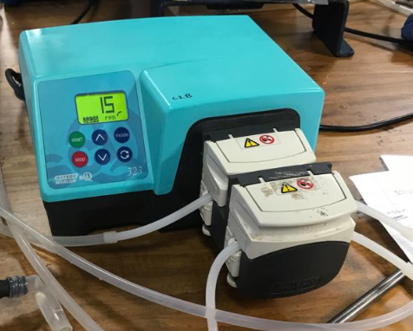
Pump:
Rpm conversion:
Set rpm
Select volume (in mL)
Time
Compensating for added head:
Rpm conversion
Add pipes to reactor
Measure flow rate at reactor outlet
Adjust rpm

Slide 5
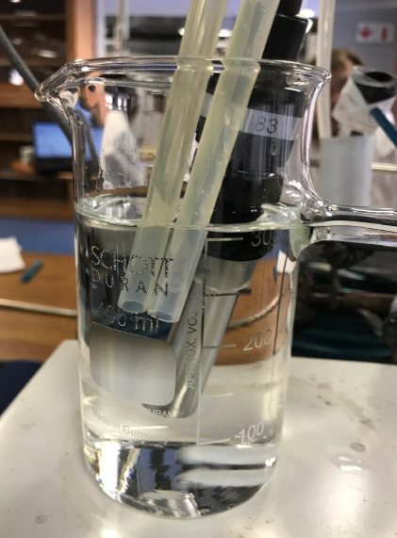

CSTR
k = 0.0114, m = 2, n = 0
Error = 1.32 e – 6
$R^{2}=0.9335$
Flow rates: 24, 30, 50, 60 (mL/min)
V = 300 mL
Ethyl acetate: 0.08 mol/L supplied
Sodium hydroxide: 0.04 mol/L supplied
Mole balance:
$$F_{AO} − F_{A}=− r_{A}∙V$$

Slide 6
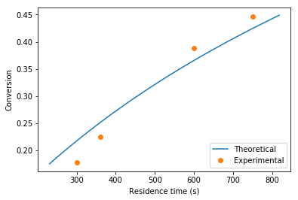
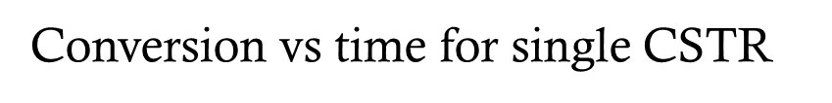

Slide 7
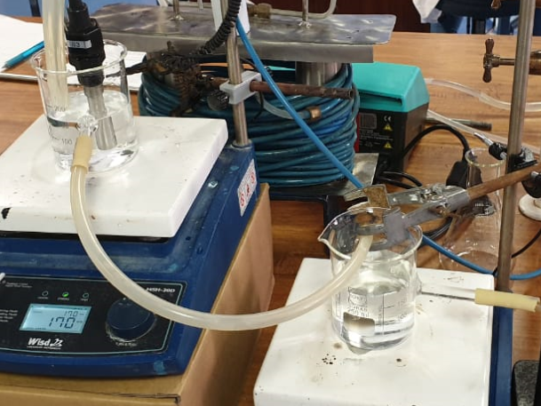
Two CSTR’s in Series
k, m & n obtained from single CSTR runs
CSTR1 K higher than CSTR2 K
Overall x predicted lower than experimental
CSTR1 x > theoretical x, CSTR2 x < theoretical x
Reaction rate in CSTR1 > CSTR2

Slide 8
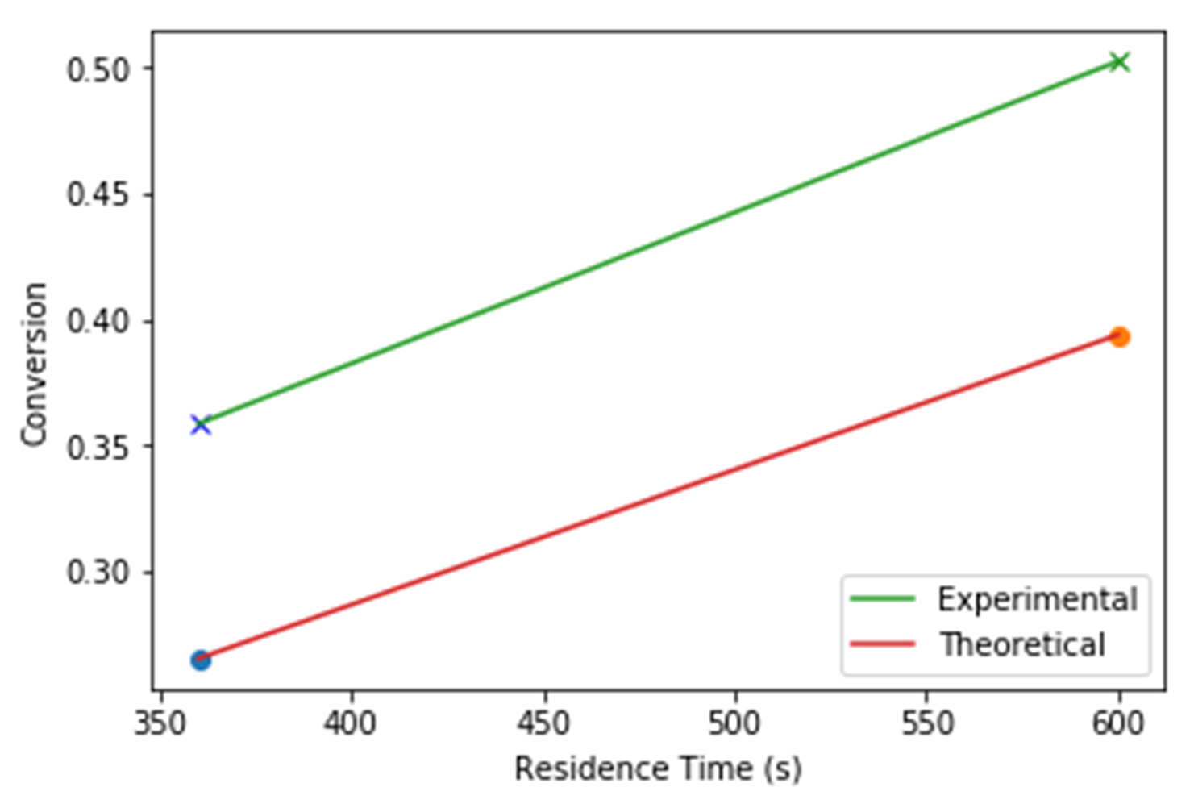
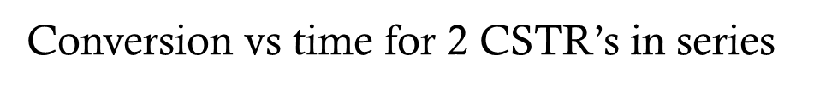

Slide 9

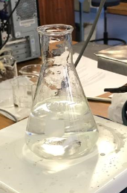
Batch
(5.540)
(3.715)

Slide 10
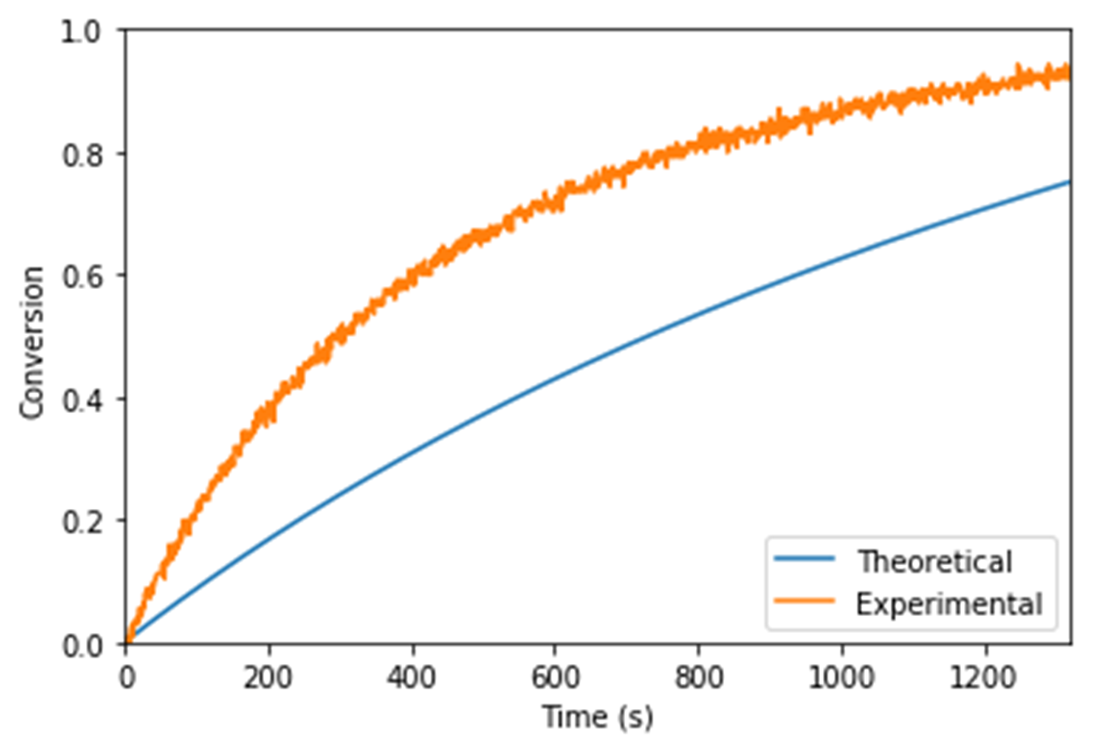
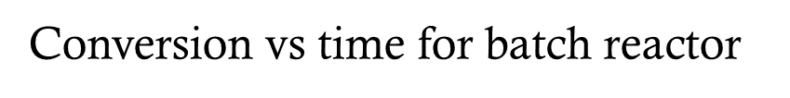

Slide 11
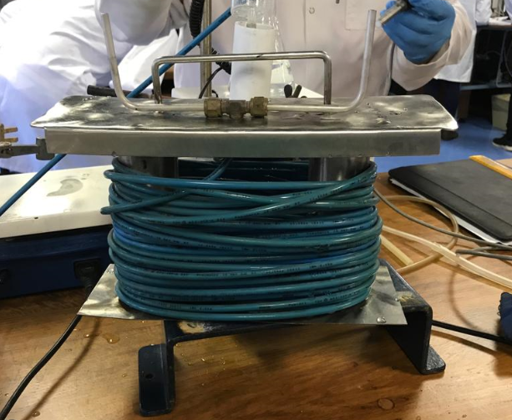

PFR
Volume:
251 mL
L = 20m
D = 4 mm
261 mL
Fill & Empty
Estimated run time:
30 mL/min – 29 min
50 mL/min – 14 min
Mole balance:
$${{dF}_{A}}/{dV}= r_{A}$$

Slide 12
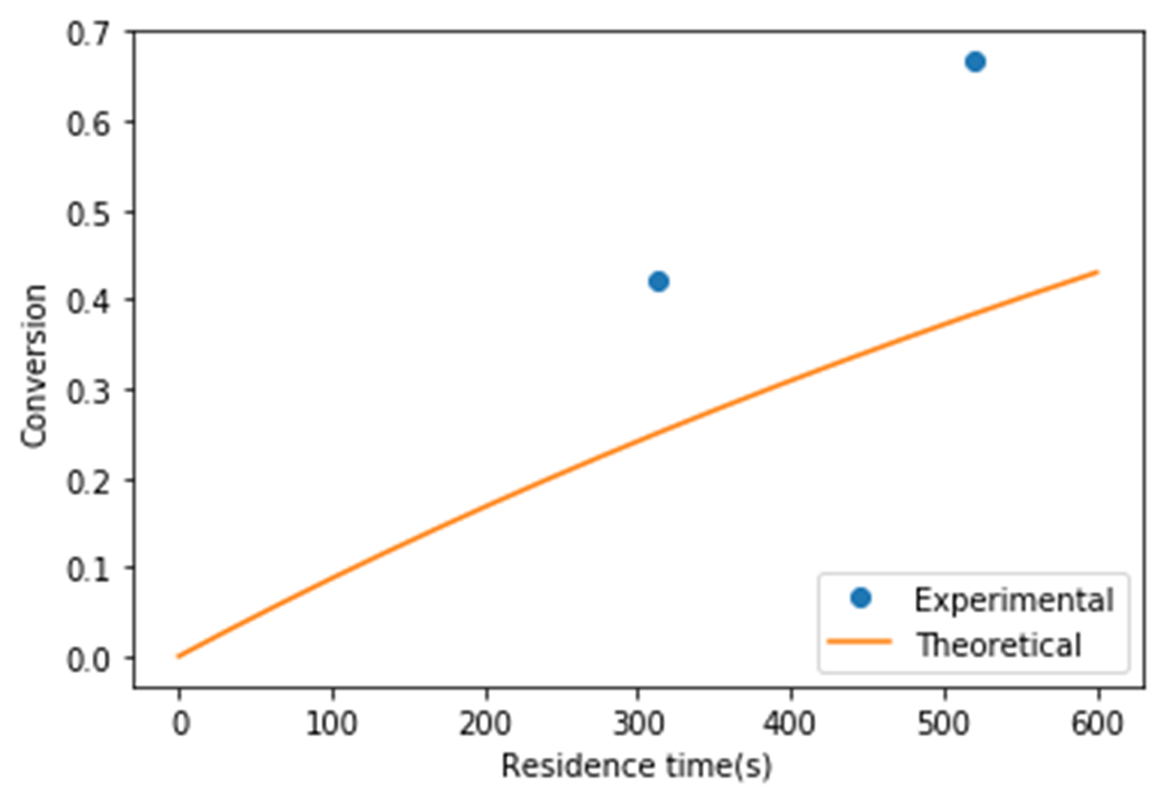
Conversion vs residence time (s)

Slide 13

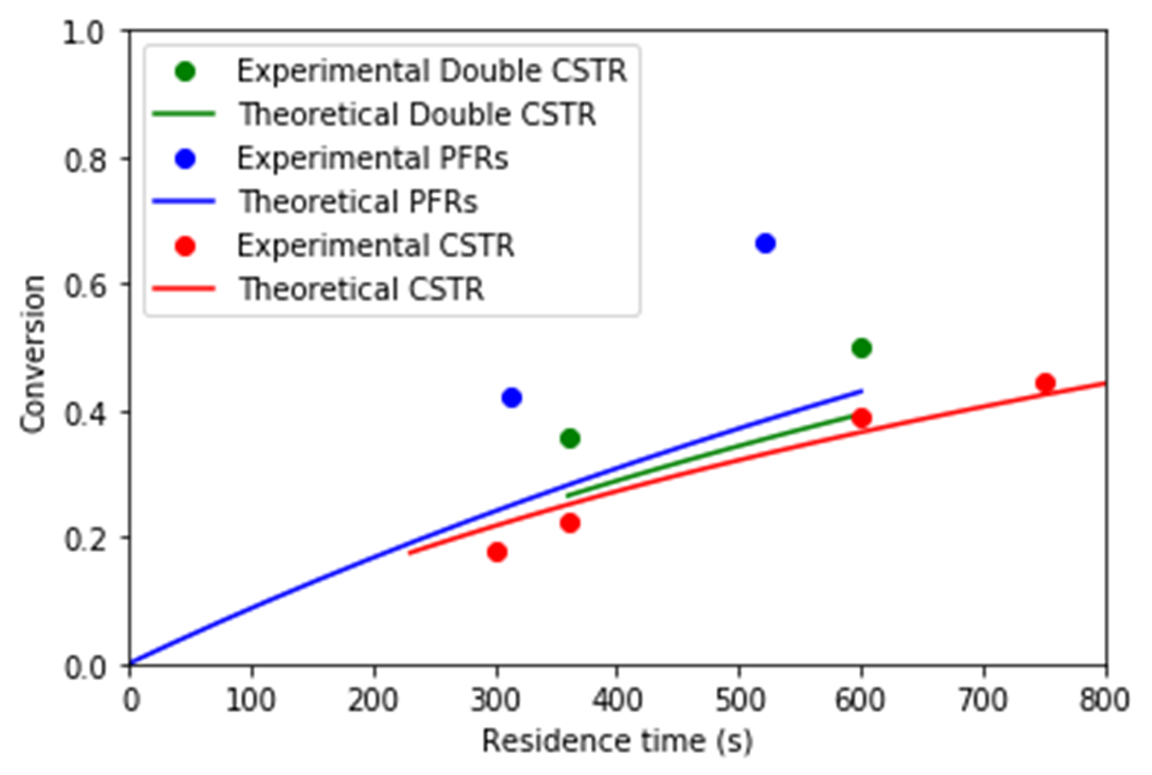

Slide 14

Rate constant (k) at ambient temperature
k = 0.0114 , m = 2 , n = 0
Units:
$r_{A} = − k∙C_{A}^{m}∙C_{B}^{n}$
$\left[\frac{mol}{L∙s}\right]=\left[\frac{L^{(m+n−1)}}{{mol}^{(m+n−1)}∙s}\right]∙{\left[\frac{mol}{L}\right]}^{m}∙{\left[\frac{mol}{L}\right]}^{n}$
$$∴k=0.0114 [\frac{L^{1}}{{mol}^{1}∙s}]$$

